Slide 1

Single-Cycle RISC-V Processor With One Level Cache Memory

Slide 2
Introduction
RISC V is RISC Processor
RISC V Operates on 32- bit Data
RISC V has 32-bit 32 register in register file

Slide 3
RISC V Processor Microarchitecture
Processor Design Includes Main Modules:
Data Path
Control Unit
Then integrate it with Cache System
-Our Design Covers instructions:
Lw , Sw
R-Type ,I-Type
Beq , jal

Slide 4
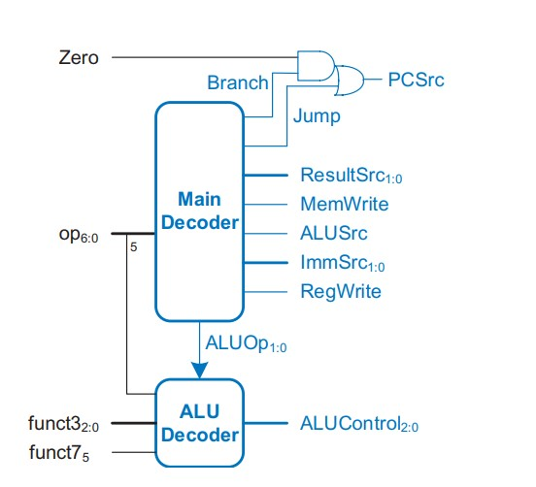
RISC V Processor Microarchitecture
Control Unit:
Generates Control Signals.

Slide 5
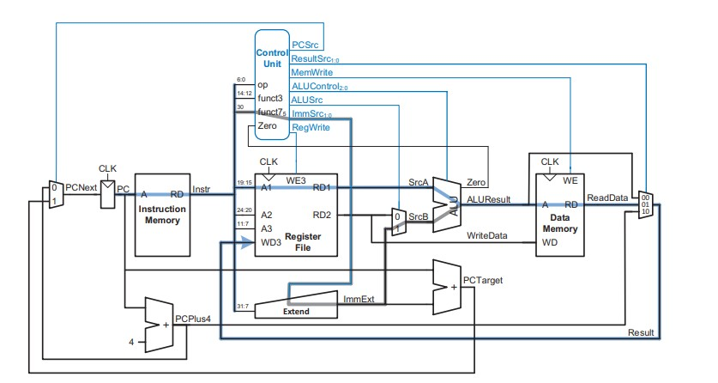
RISC V Processor Microarchitecture
Data Path:

Slide 6
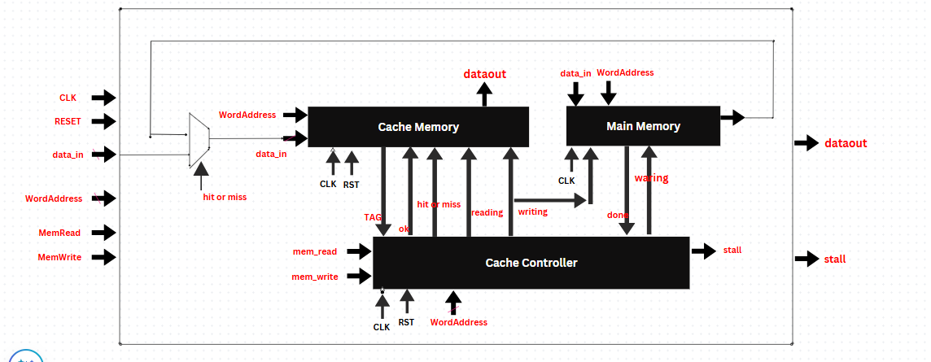
RISC V Processor Microarchitecture
Cache System:

Slide 7
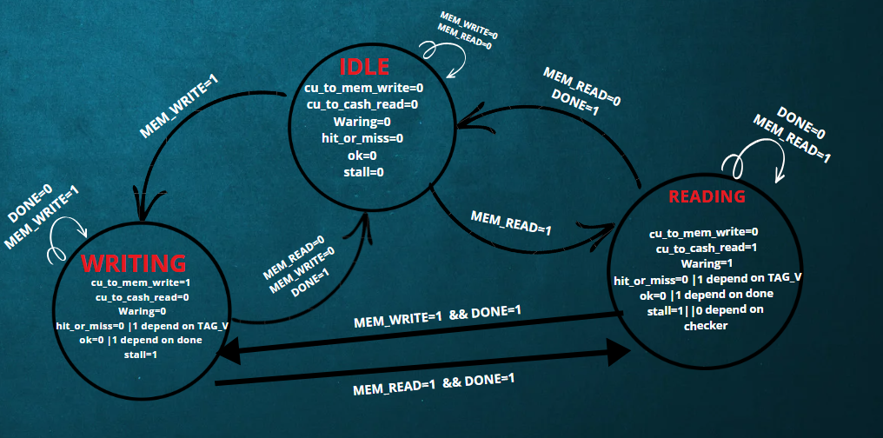
RISC V Processor Microarchitecture
FSM

Slide 8
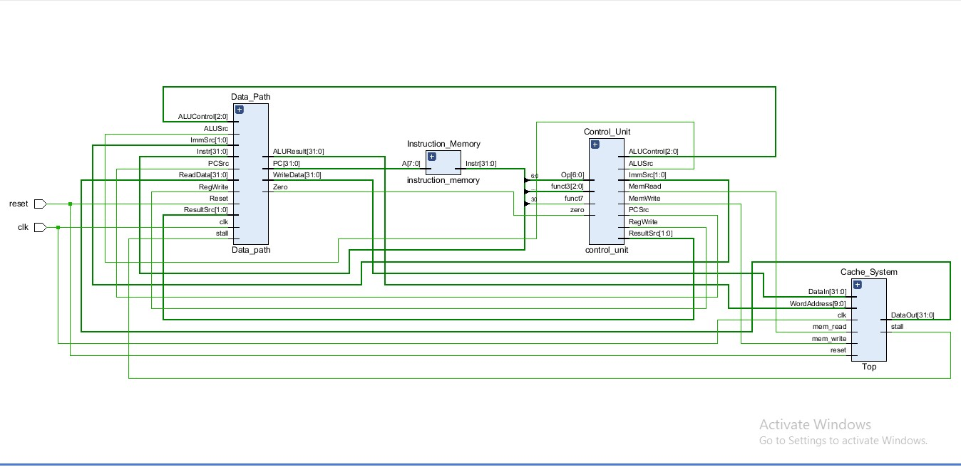
RISC V Schematic

Slide 9
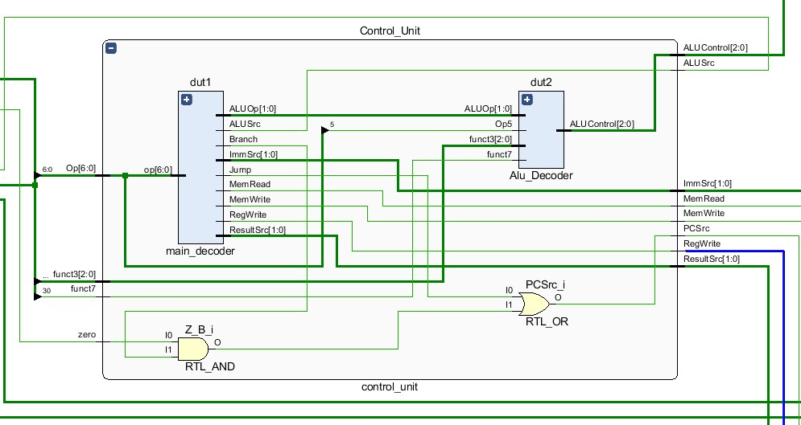
RISC V Schematic
Control Unit:

Slide 10
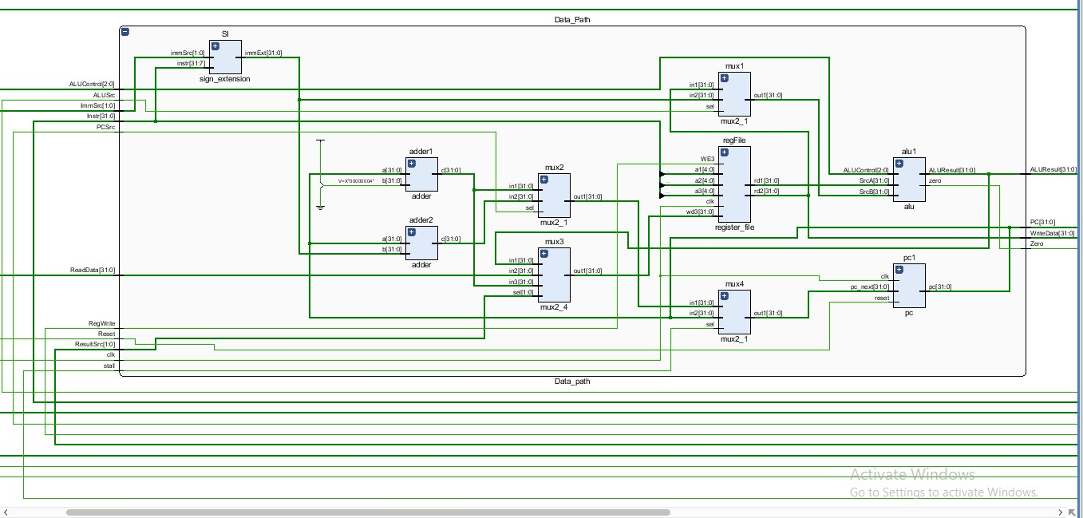
RISC V Schematic
Data Path:

Slide 11
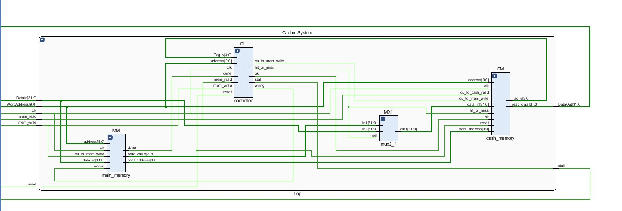
RISC V Schematic
Cache System:

Slide 12
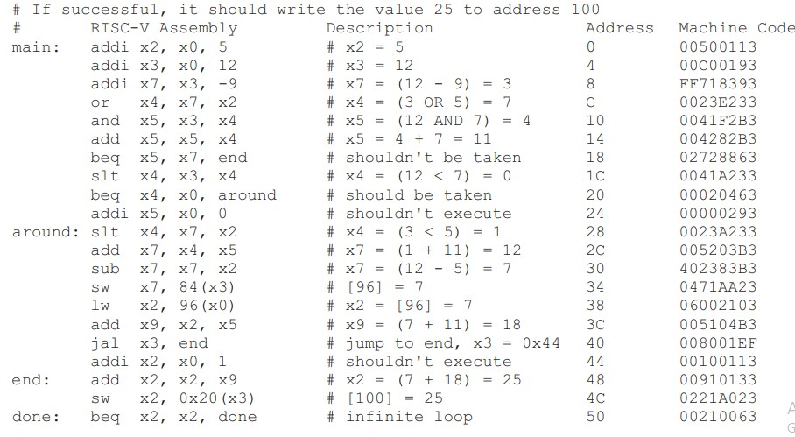
RISC V Test Program
The Program writes the value 25 to address 100

Slide 13
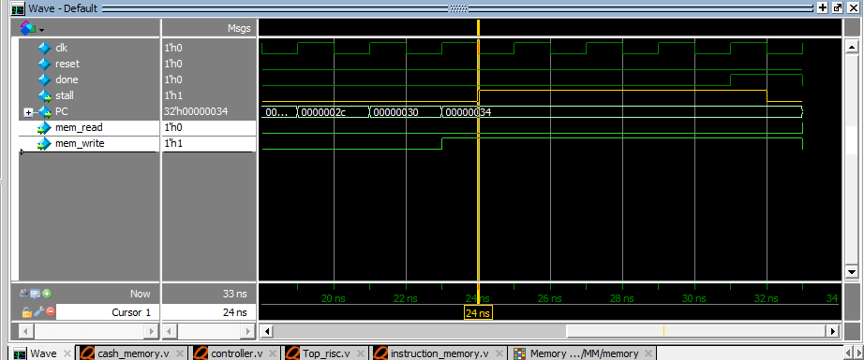
Simulation Results
sw x7, 84(x3): Store 7 in location 96

Slide 14
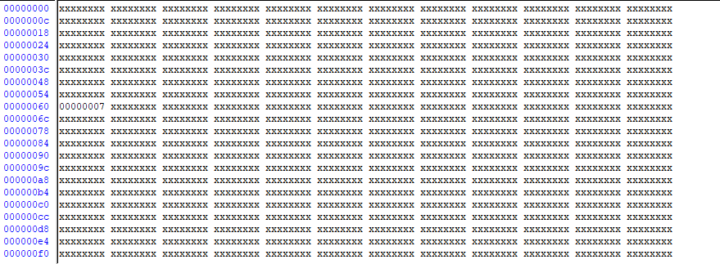
Simulation Results
sw x7, 84(x3) : Main Memory view

Slide 15
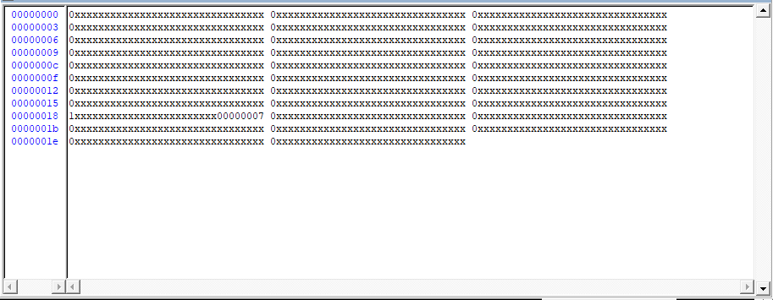
Simulation Results
sw x7, 84(x3) : Cache Memory View

Slide 16
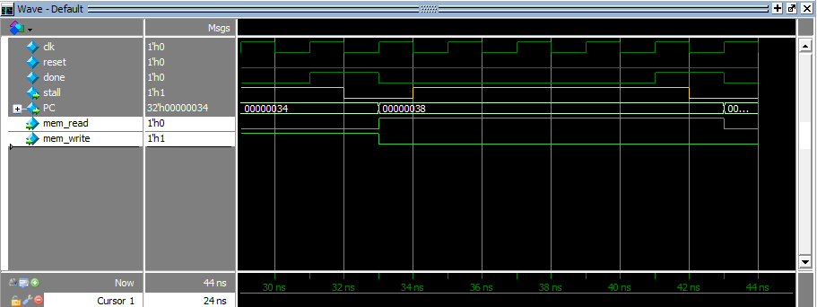
Simulation Results
lw x2, 96(x0): load from location 96 to register x2

Slide 17
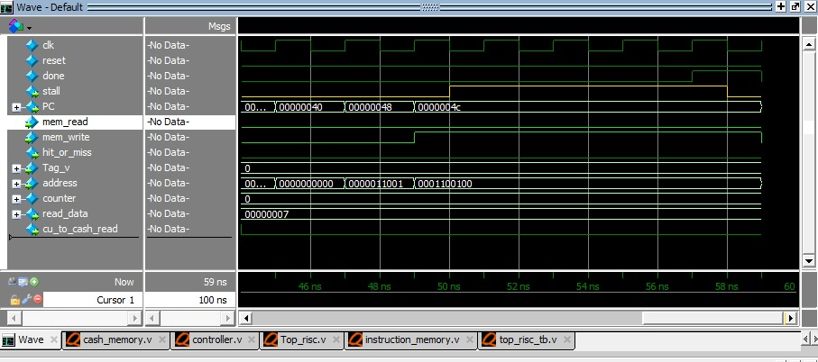
Simulation Results
sw x2, 0x20(x3)

Slide 18
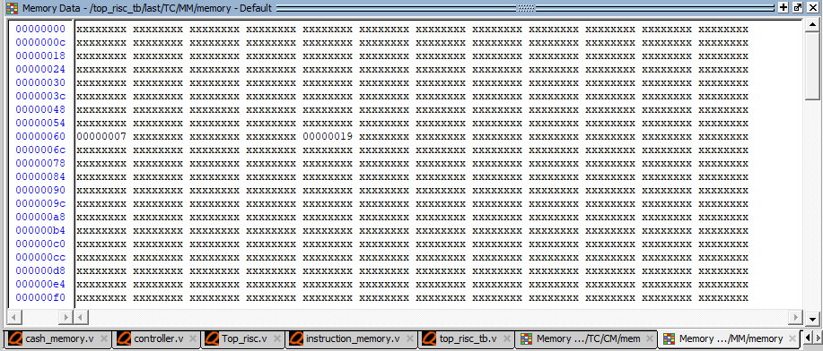
Simulation Results
sw x2, 0x20(x3) : Main Memory view 0x19 Stored in in Location 0x64

Slide 19
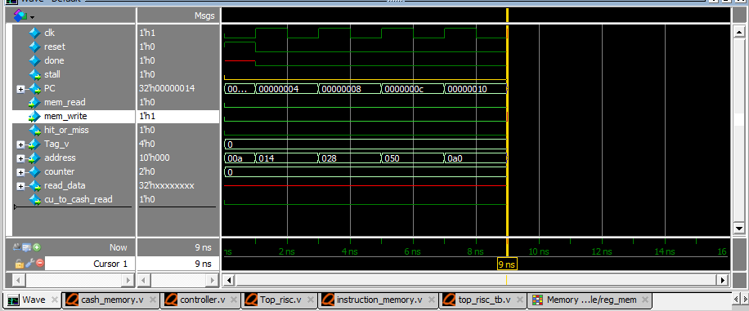
Other Test Program
addi x1, x0, 10
addi x2, x0, 20
addi x3, x0, 40
addi x4, x0, 80
addi x5, x0, 160

Slide 20
Simulation Results
Store 10,20,40,80,160 in register file

Slide 21
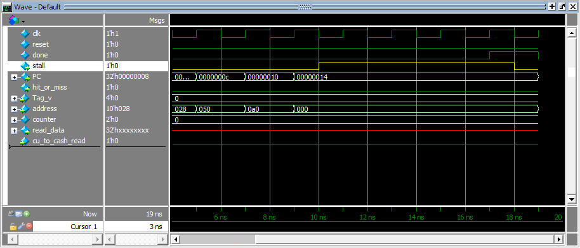
Simulation Results
sw x1, 0(x0)

Slide 22
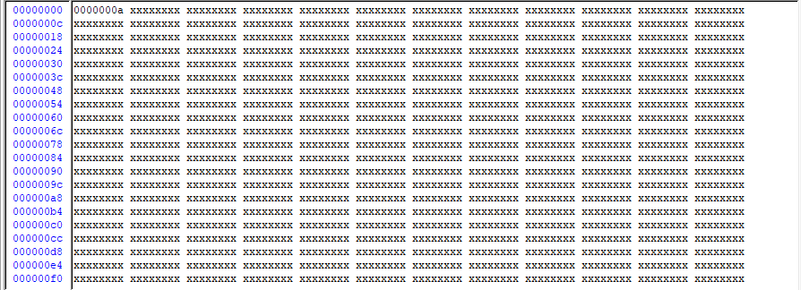
Simulation Results
Store 10 in location 0x00000000

Slide 23
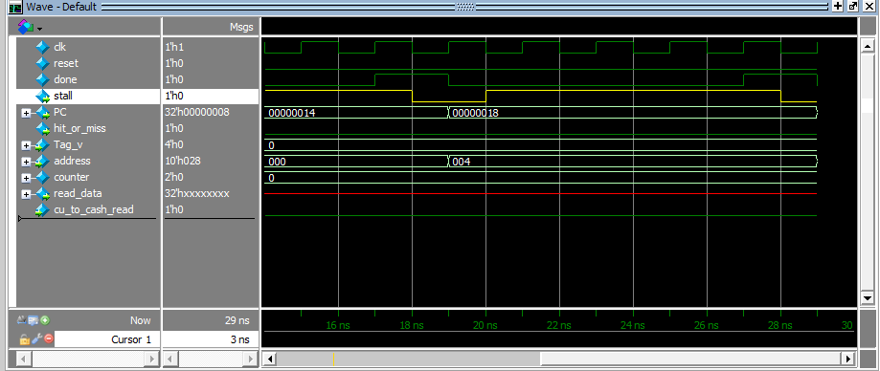
Simulation Results
sw x2, 4(x0)

Slide 24
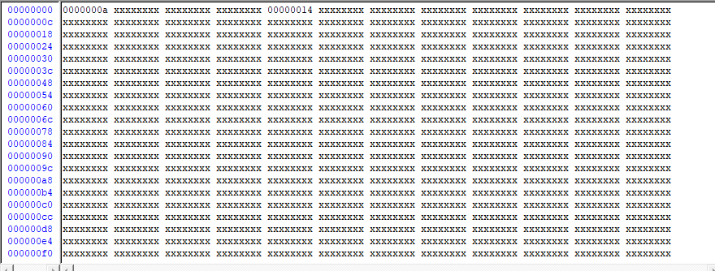
Simulation Results
Store 20 in location 0x00000004

Slide 25
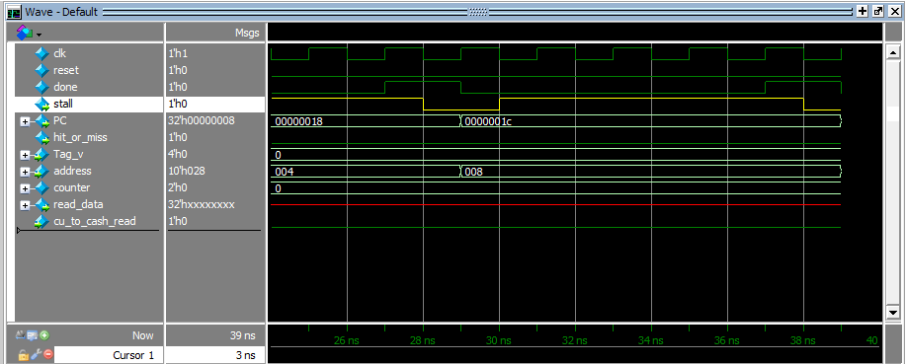
Simulation Results
sw x3, 8(x0)

Slide 26
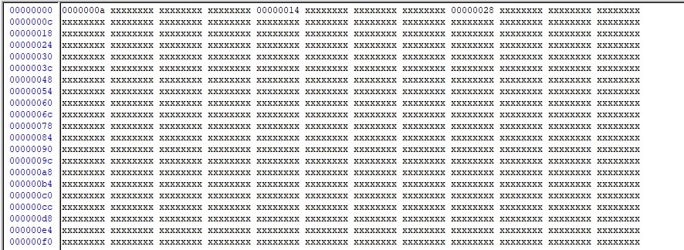
Simulation Results
Store 40 in location 0x00000008

Slide 27
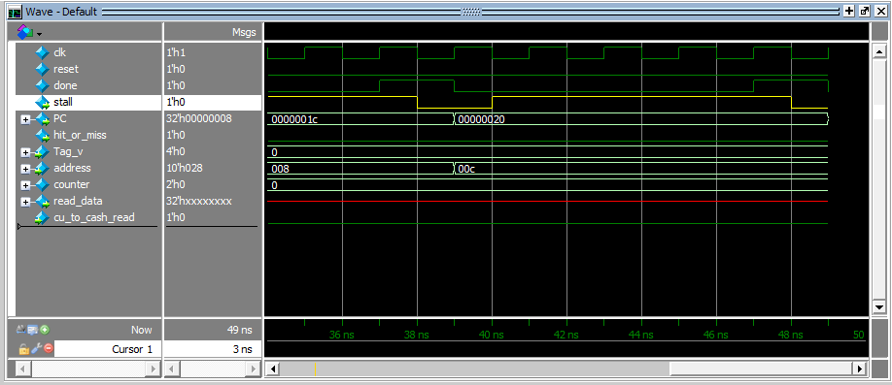
Simulation Results
sw x4, 12(x0)

Slide 28
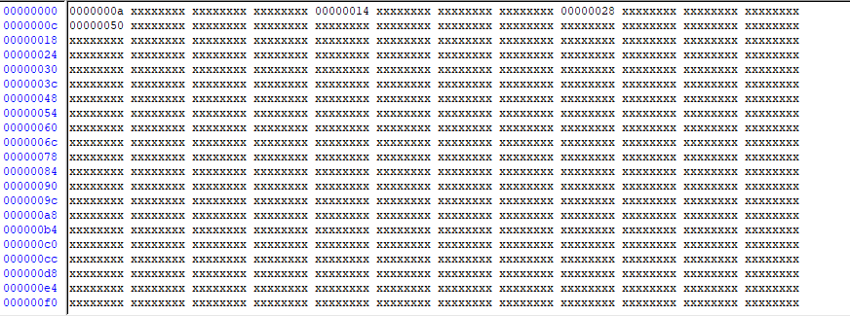
Simulation Results
Store 0x80 in location 0x0000000c

Slide 29
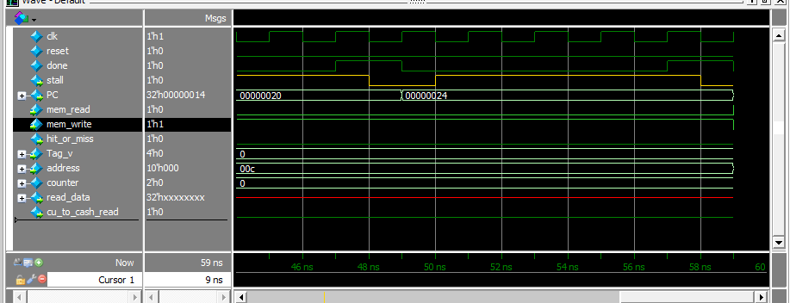
Simulation Results
sw x5, 12(x0)

Slide 30
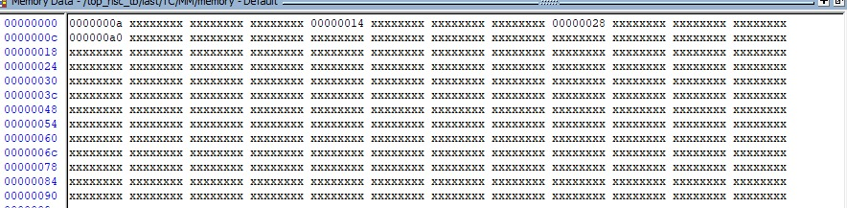
Simulation Results
Store 0x160 in location 0x0000000c

Slide 31
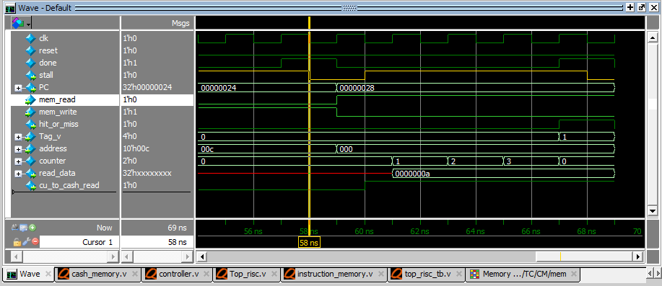
Simulation Results
lw x10, 0(x0)

Slide 32
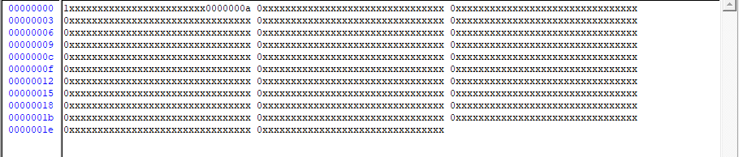
Simulation Results
Store block 1 in cache memory then read the value 10

Slide 33
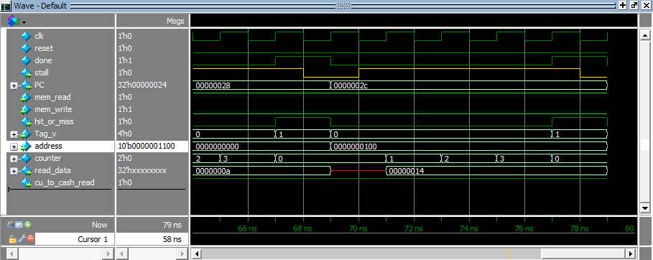
Simulation Results
lw x11, 4(x0)

Slide 34
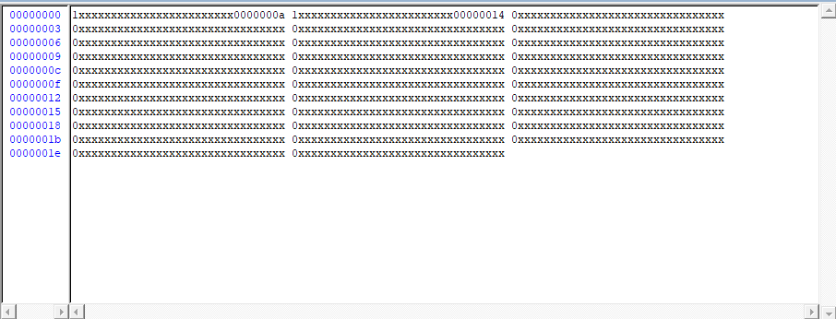
Simulation Results
Store block 2 in cache memory then read the value 20

Slide 35
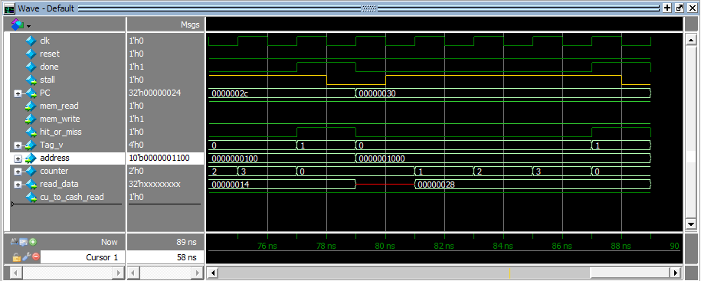
Simulation Results
lw x12, 8(x0)

Slide 36
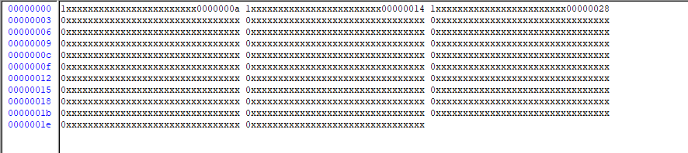
Simulation Results
Store block 3 in cache memory then read the value 40

Slide 37
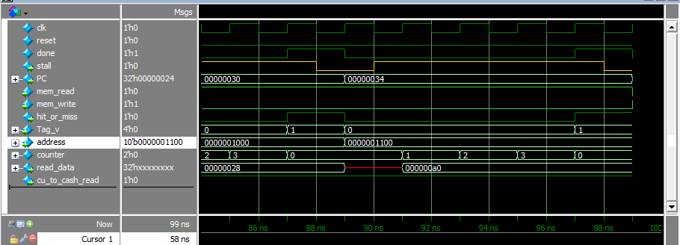
Simulation Results
lw x13, 12(x0)

Slide 38
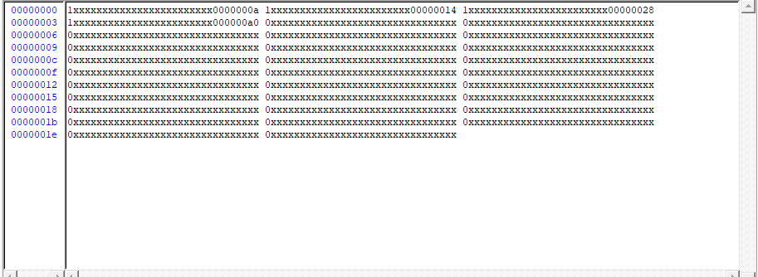
Simulation Results
Store block 4 in cache memory then read the value 160

Slide 39
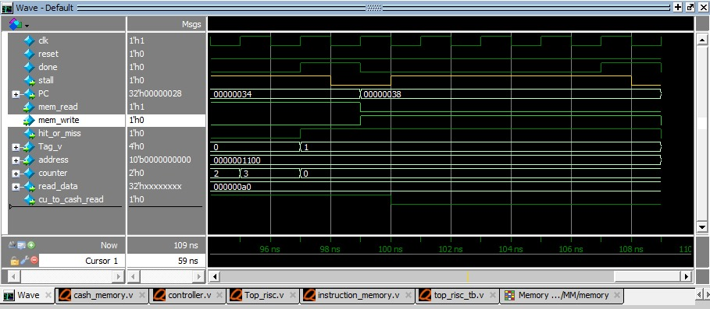
Simulation Results
sw x4, 12(x0)

Slide 40
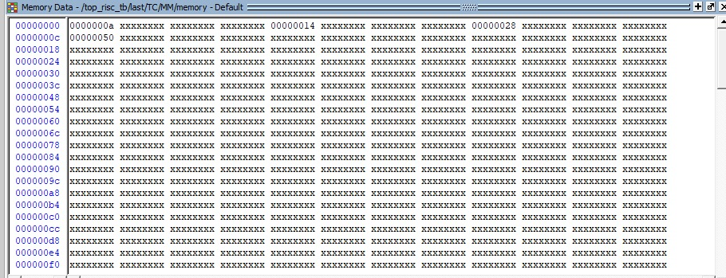
Simulation Results
sw x4, 12(x0)

Slide 41
Time’s Up!!!
Any Questions ?

Slide 42

Thank You
Special Thanks to our instructors & Supervisor
.Eng Ahamed El-Gammal
.Eng Fayza Hamada
.Eng Ahmed El-Gayar

